Slide 1




BSMM-8720: Data Analytics & Project Management Master of Management Summer 2023
Divyasree Geetha Balasubramanian

Slide 2


COVID-19 Analysis Dashboard
This presentation provides an overview of a comprehensive analysis of the COVID-19 pandemic in the United States of America using data sourced from JHU CSSE COVID-19 Data and The New York Times (which have aggregating data from state and local governments and health departments in the US). It includes a dashboard with multiple visualizations and data-driven insights on the spread of the disease, the number of positive cases, and number of deaths. The main objective is to understand the impact of COVID-19 in the United States from Jan 2020 - April 2022 to enable decision-making for policymakers and healthcare professionals.

Slide 3

COVID-19 Data Source
The dataset in the repository is structured in a manner that allows for detailed analysis. It includes information such as dates, geographic locations, and demographic characteristics.
It provides a comprehensive and granular view of excess deaths, allowing researchers, analysts, and the general public to explore and analyze the data. By examining excess deaths, it becomes possible to understand the broader impact of the pandemic, including both direct and indirect consequences.

Slide 4

Overview of the Dashboard
This dashboard consists of several visualizations and data-driven insights:
COVID-19 Overview: United States map showcasing the number of positive cases, and deaths.
Key Metrics and Trends: Visualizations displaying total cases, deaths, and active cases over time.
Hotspot Analysis: Heat maps or clustering algorithms identify regions with high infection rates.

Slide 5
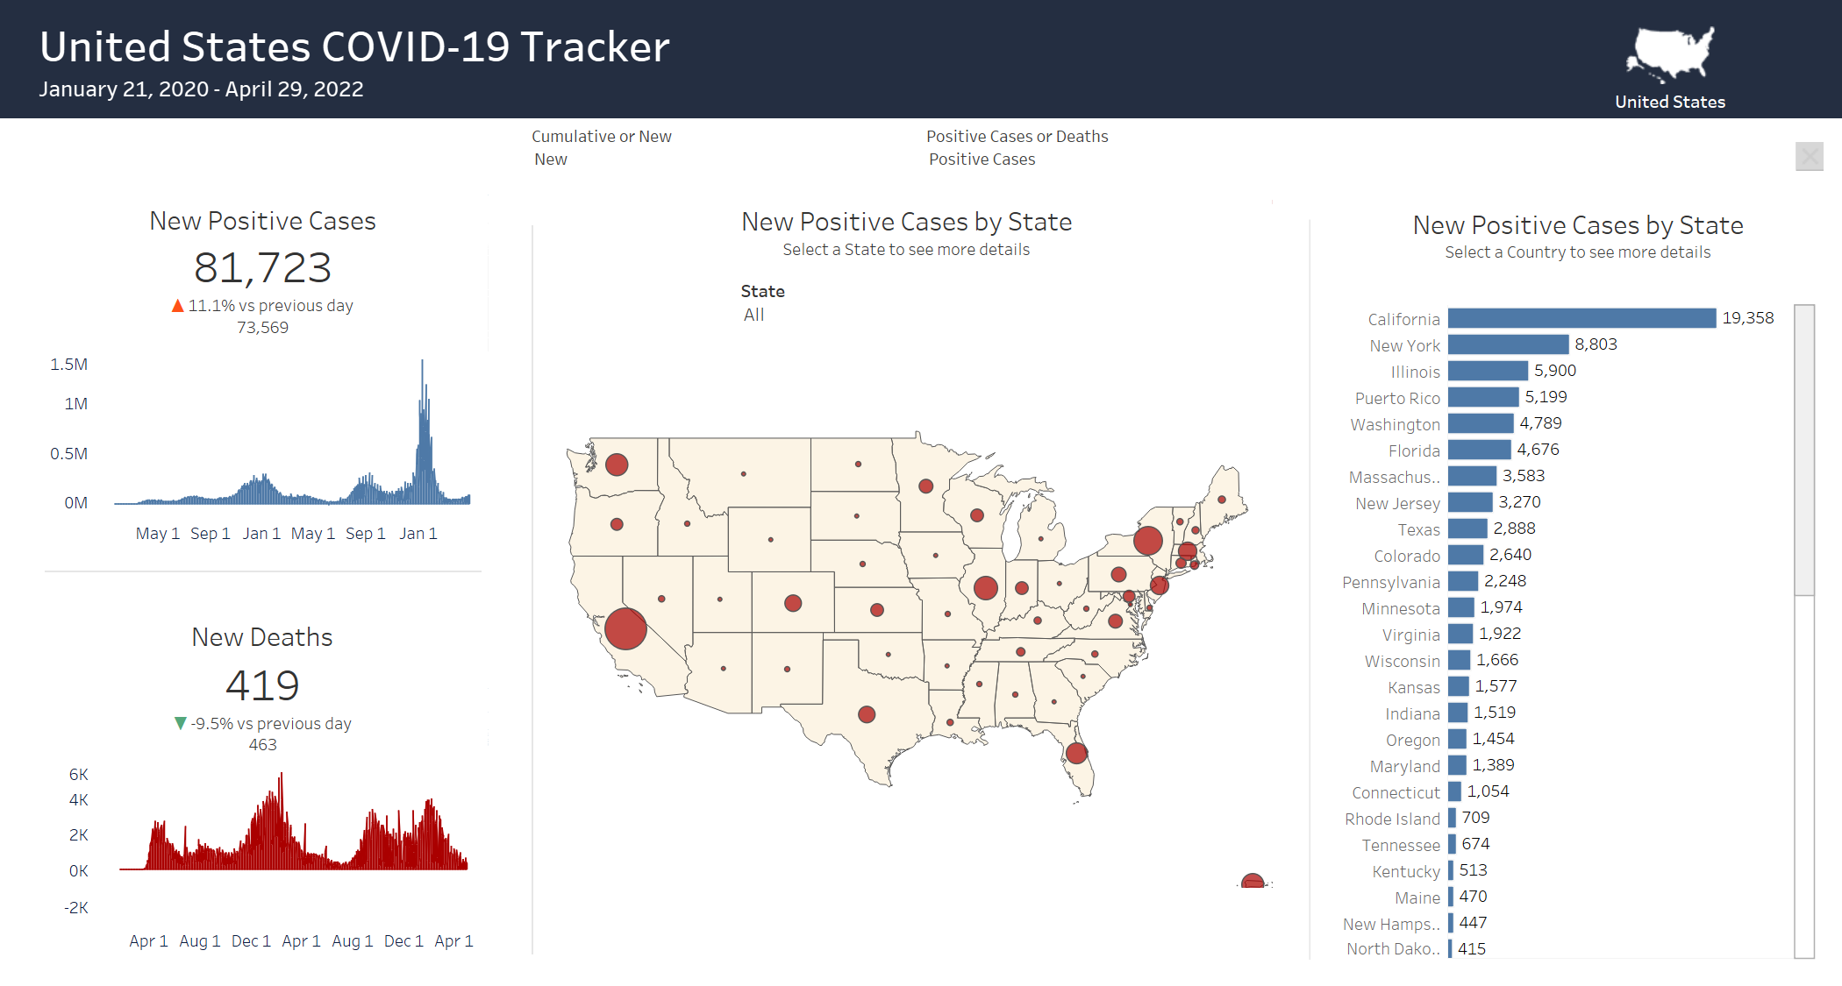

Slide 6

Statistical Method Used for Analysis
Regression analysis is a statistical method used to examine and quantify the relationship between a dependent variable and one or more independent variables. It aims to understand how changes in the independent variables affect the dependent variable.
In regression analysis, the dependent variable is the variable being predicted or explained, while the independent variables are the predictors or factors that potentially influence the dependent variable. The relationship between the variables is typically modeled as a mathematical equation, and the analysis estimates the coefficients of the equation to describe the relationship.

Slide 8
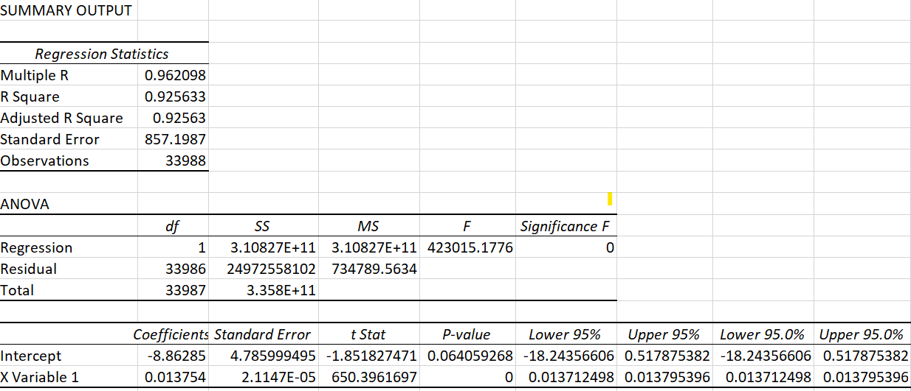

Slide 9
The Conclusion
This analysis shows a positive relationship between the number of deaths and the number of positive cases.
The coefficient of determination (R-squared) is commonly used to assess the proportion of the variance in the dependent variable explained by the predictors used for the fit test. Higher R-squared values indicate a stronger relationship, 92 percent of the data fit the regression analysis.
For every new positive case, there will be 0.0138 times increase in death count as indicated by the linear regression equation.

Slide 10
The Conclusion
Overall, the dataset serves as a valuable resource for studying the broader impact of the COVID-19 pandemic on infection rates. It enables researchers and analysts to explore patterns, uncover insights, and contribute to the understanding of the pandemic's consequences beyond the reported COVID-19 deaths. Lastly, It helps to identify trends across different regions or demographic groups and assess the correlation between excess deaths and various factors.

Slide 11

Thank you for your time

